Slide 1
ADO.NET
Information Processing techniques
Week 14

Slide 2
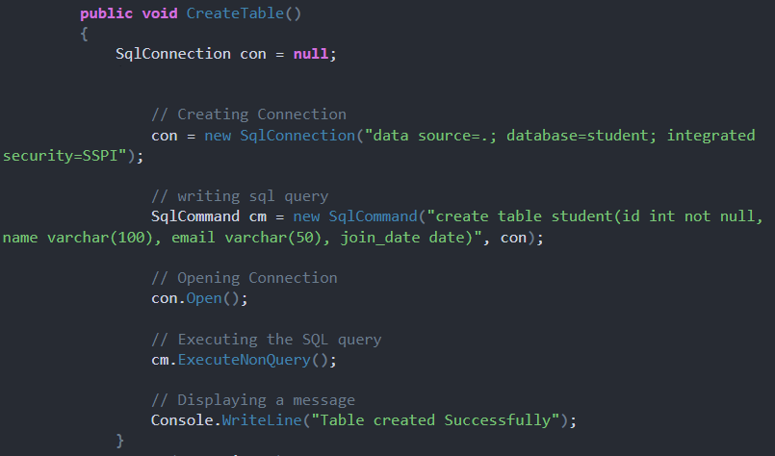
Connection and Create Table
Import using System.Data.SqlClient;

Slide 3
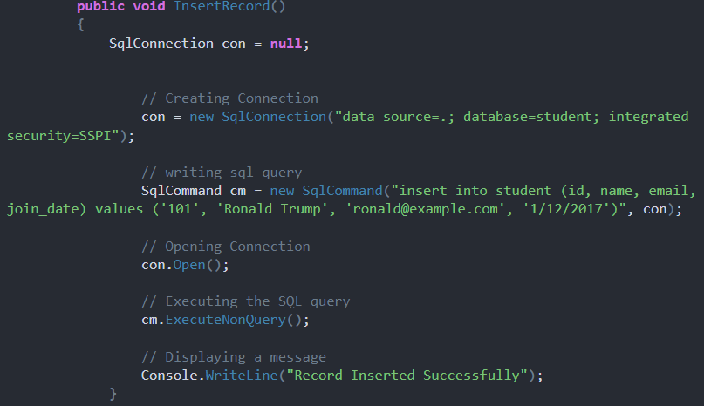
INSERT record

Slide 4
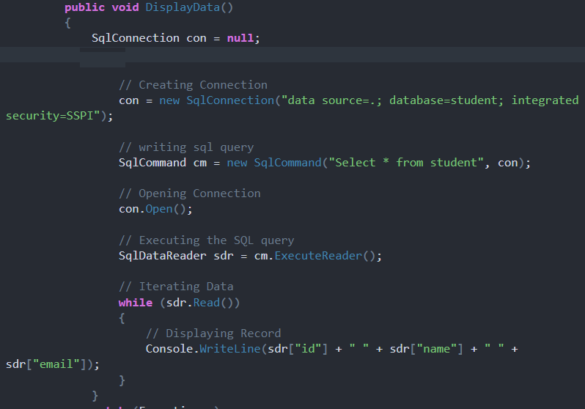
SELECT record

Slide 5
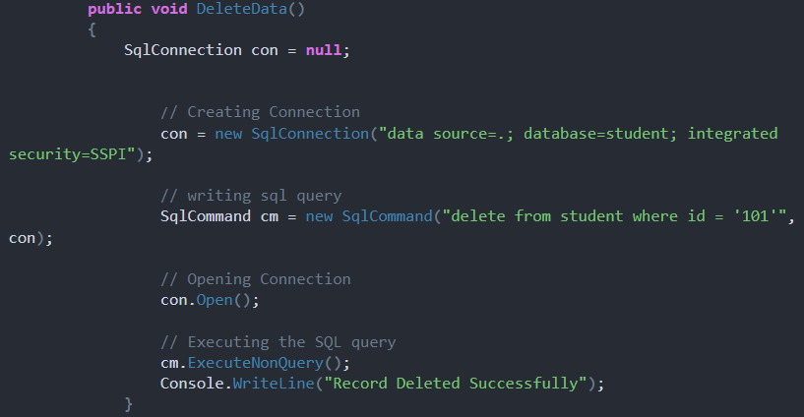
DELETE record

Slide 6
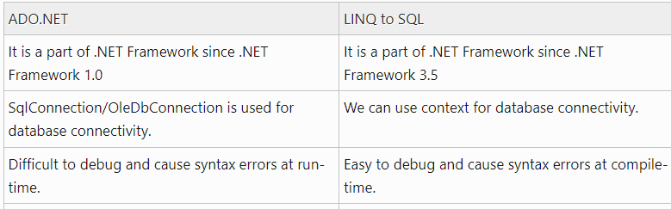
LINQ vs Ado.net
Notes:
Key feature of C# 3.0 and VB 9

